Slide 1
Chapter - 4
C# Windows Form Application

Slide 2
Contents
Windows Form Application
C# Windows Forms Controls

Slide 3
Windows Forms Basics
Windows Forms =Graphical User Interface(GUI )
Allows the user to interact visually with a program

Slide 4
Building GUI
GUI's are built from GUI controls
Also known as components or widgets
They are objects that can:
Display information on the screen, or
Enable users to interact with an application via the mouse, keyboard or other form of input
Examples - commonly used types of GUI controls
Label, Textbox, Button, Checkbox Combo Box, List Box

Slide 5
Cont.…
GUI elements are classified in to different groups
Data
Design
Behavior
Component
Container
Dialogs

Slide 6
GUI in MS Visual Studio for C#:
Windows Forms (or “Forms”) –
Used to create GUI's for C# programs
Create graphical elements that appear on the desktop (dialog, window, etc.)
A Windows forms application is one that runs on the desktop computer. The Form is blank space at first.
You then add controls to your form, things like buttons, text boxes, menus, check boxes, radio buttons, list box, other.

Slide 7
Cont.…
After selecting Windows Forms Application , you can see a default Form (Form1) in your new C# project.
The Windows Form you see in Designer view is a visual representation of the window that will open when your application is opened.
You can switch between this view and Code view at any time by right-clicking the design surface or code window and then clicking View Code or View Designer.

Slide 8
Using Toolbox in Visual Studio to Create GUIs
The controls and components of C# are found in the C# Toolbox in Visual Studio
Organized by functionality
To open Toolbox (takes time!):
Menu/Item: View>>Toolbox:
To add a component to a Form:
Select that component in Toolbox
Drag it onto the Form

Slide 9
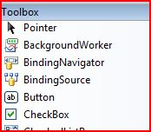
Using the Toolbox - Basics
(After you open it with: View>>Toolbox), the toolbox is located on the left-hand side of the VS screen
Click on the control you want to add and drag it to the form

Slide 10
C# Button Control
A Message Box – a statement printed on a button click
private void button1_Click(object sender, EventArgs e)
{
MessageBox.Show("you are in button one");
}
Button1 is the name of the button
_Click part after button1 is called an Event

Slide 11
Cont …
You can add a Title quite easily
private void button1_Click_1(object sender, EventArgs e)
{
MessageBox.Show("you are in button one", "Hello");
}
Hello will display as the title of the message box

Slide 12
Other Button Options
Rather than having just an OK button, you can add buttons like Yes, No, and Cancel. We’ll add a Yes and a No button.
private void button1_Click_1(object sender, EventArgs e)
{
MessageBox.Show("My first Message", "Message", MessageBoxButtons.YesNo);
}
RetryCancel
YesNoCancel …..

Slide 13
Adding Icons to a Message Box
private void button1_Click_1(object sender, EventArgs e)
{
MessageBox.Show("My first Message", "Message", MessageBoxButtons.YesNo,MessageBoxIcon.Asterisk);
}
MessageBoxIcon.Question
MessageBoxIcon.Error

Slide 14
Code which create Button itself
Button btnImage = new Button();
this.Text = "This is Button";
btnImage.Visible = true;
MessageBox.Show("Hello the world of Programmers");
btnImage.BackColor = Color.Red;
btnImage.Text = "Hello";
this.Controls.Add(btnImage);

Slide 15
C# Label Control
We can use the Label control to display text in a set location on the page.
Label controls can also be used to add descriptive text to a Form to provide the user with helpful information.

Slide 16
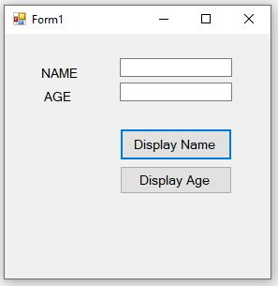
Cont.…

Slide 17
C# Text-Box Control
A text box object is used to display text on a form or to get user input while a C# program is running.
User can type data or paste it into the control from the clipboard.
This control has additional functionality that is not found in the standard Windows text box control, including .
Multiline editing and
Password character masking.
Message Box only displays text

Slide 18
Example-1
private void button1_Click(object sender, EventArgs e)
{
string fristName;
fristName = textBox1.Text;
MessageBox.Show(fristName);
}
private void button2_Click(object sender, EventArgs e)
{
string age;
age = textBox2.Text;
MessageBox.Show(age);
}

Slide 19
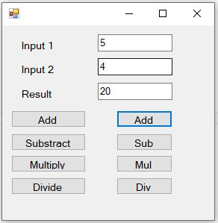
Example-2 Simple Calculator
private void button1_Click(object sender, EventArgs e)
{
int a,b,c;
a = int.Parse(textBox1.Text);
b = int.Parse(textBox2.Text);
c = a + b;
MessageBox.Show(c.ToString());
}
private void button2_Click(object sender, EventArgs e)
{
int a, b, c;
a = int.Parse(textBox1.Text);
b = int.Parse(textBox2.Text);
c = a-b;
MessageBox.Show(c.ToString());
}

Slide 20
Example-2 Simple Calculator
private void button5_Click(object sender, EventArgs e)
{
int a, b, c;
a = int.Parse(textBox1.Text);
b = int.Parse(textBox2.Text);
c = a + b;
textBox3.Text = c.ToString();
}
private void button6_Click_1(object sender, EventArgs e)
{
int a, b, c;
a = int.Parse(textBox1.Text);
b = int.Parse(textBox2.Text);
c = a * b;
textBox3.Text=(c.ToString());
}

Slide 21
Cont..
Text Box controls can also be used to accept passwords and other sensitive information.
You can use the Password-Char property to mask characters entered in a single line version of the control.
textBox1.PasswordChar = '*';
The above code set the Password-Char to * , so when the user enter password then it display only * instead of typed characters.

Slide 22
Cont..
You can add new line in a textbox using many ways.
textBox1.Text += "your text" + "\r\n";
or
textBox1.Text += "your text" + Environment.NewLine;
Make multiline True first
Eg.
textBox3.Text = " Result is" + "\r\n" + c.ToString();

Slide 23
Form Properties
Properties: which describe the object
Each control has properties (and some methods)
Example properties:
Enable
Font
Text
Visible
Example methods:
Hide
Select
Show

Slide 24
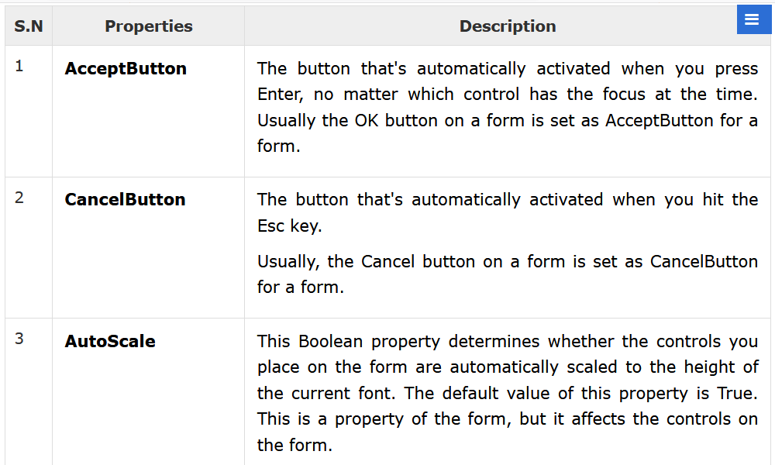
Cont.…

Slide 25
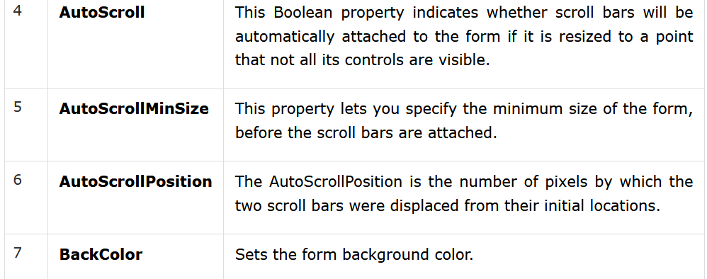
Cont.…

Slide 26
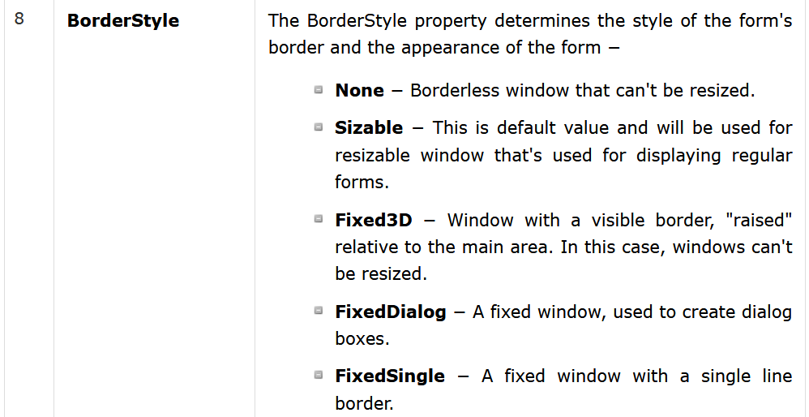
Cont.…

Slide 27
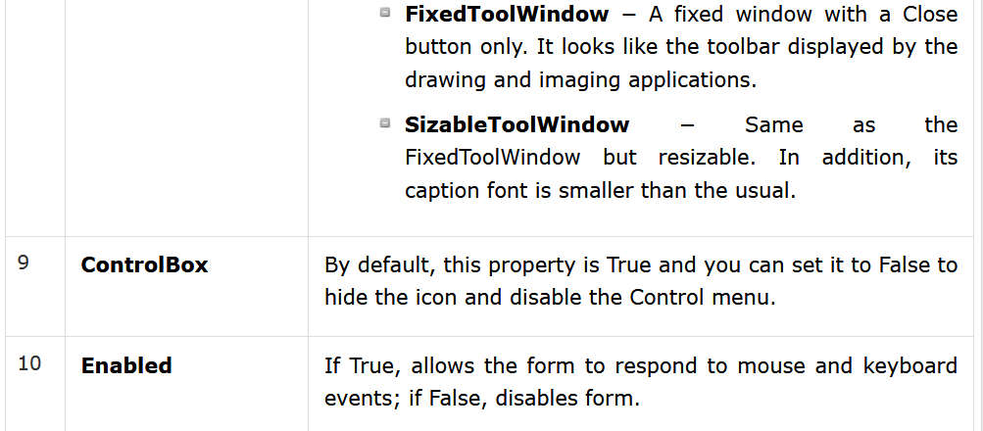
Cont.…

Slide 28
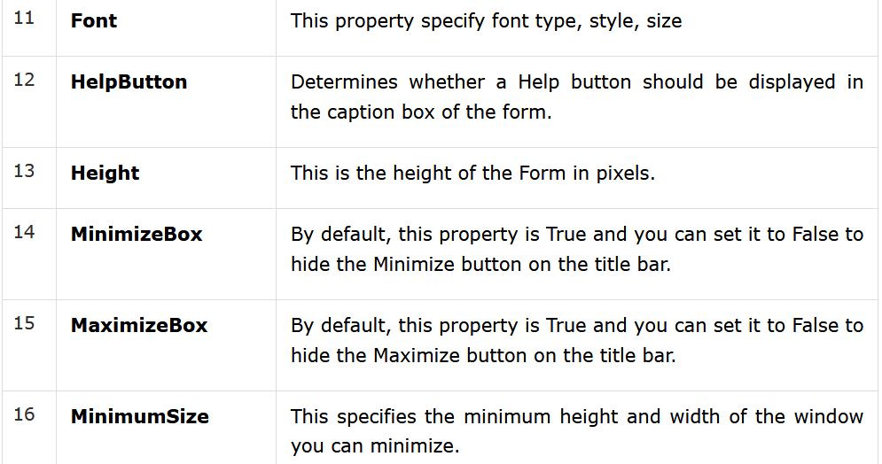
Cont.…

Slide 29
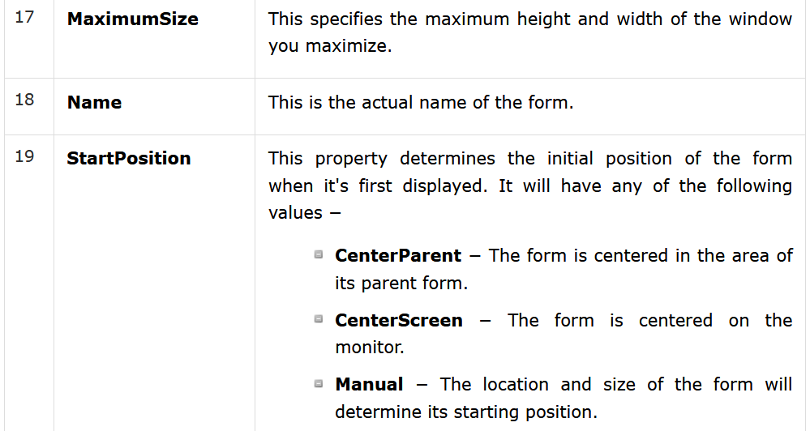
Cont.…

Slide 30
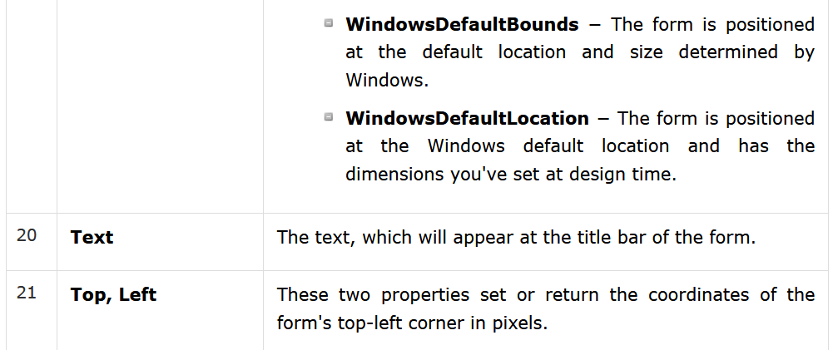
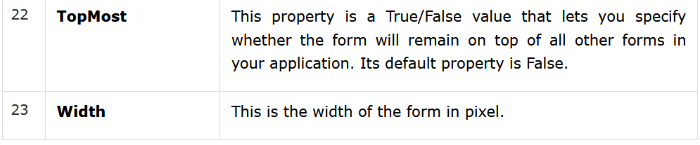
Cont.…

Slide 31
Set property using a code
private void Form1_Load(object sender, EventArgs e)
{
this.BackColor = Color.Brown;
this.Text = “Lab Exercise";
this.Size = new Size(350, 125);
this.Location = new Point(500, 200);
this.MaximizeBox = true;
}

Slide 32
Text-Box Properties
textBox1.Width = 250;
textBox1.Height = 50;
textBox1.PasswordChar = '*';
textBox1.BackColor = Color.Blue;
textBox1.ForeColor = Color.White;
textBox1.BorderStyle = BorderStyle.Fixed3D;
textBox1.MaxLength = 40;
Maximum number of characters or words the user can input
textBox1.ReadOnly = true;
Prevent a user from changing the text that appears in a text box

Slide 33
Form Methods
Methods: cause an object to do something and
Example
Close();
The following are some of the commonly used methods of the Form class.
You can refer to Microsoft documentation for a complete list of methods associated with forms control

Slide 34
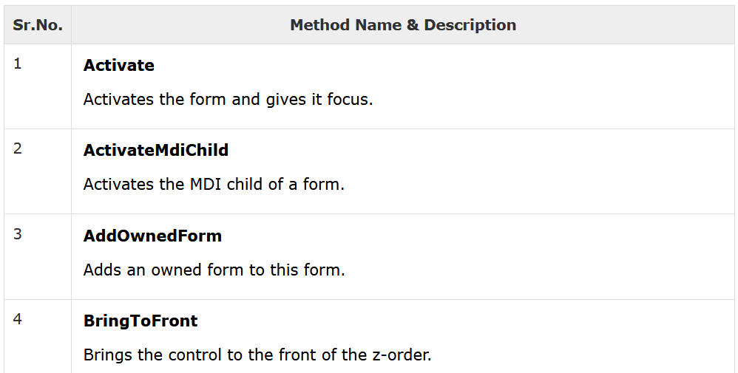
Cont.…

Slide 35
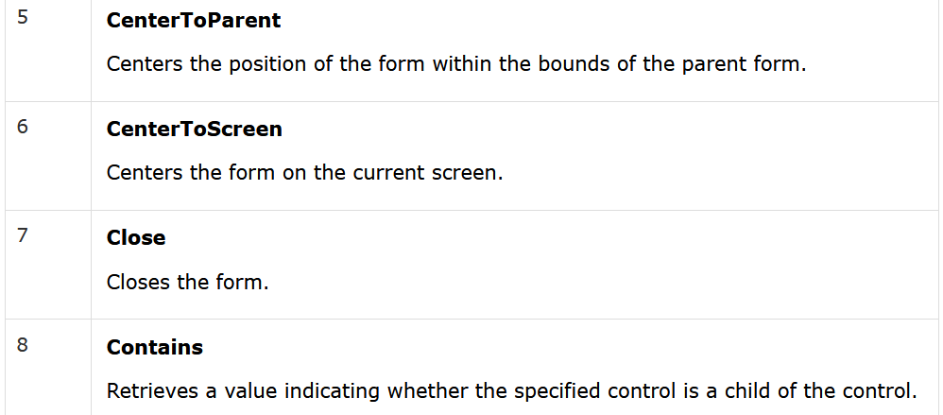
Cont.…

Slide 36
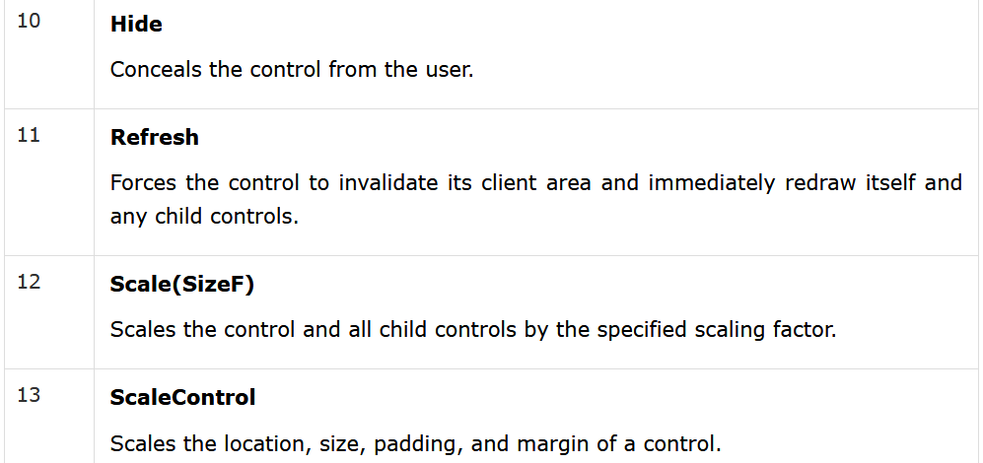
Cont.…

Slide 37
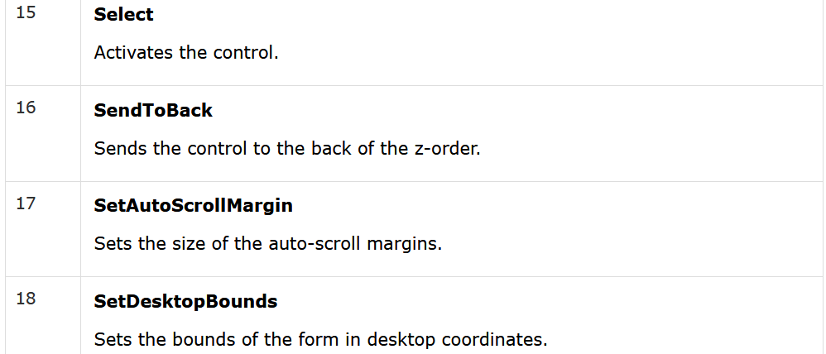
Cont.…

Slide 38
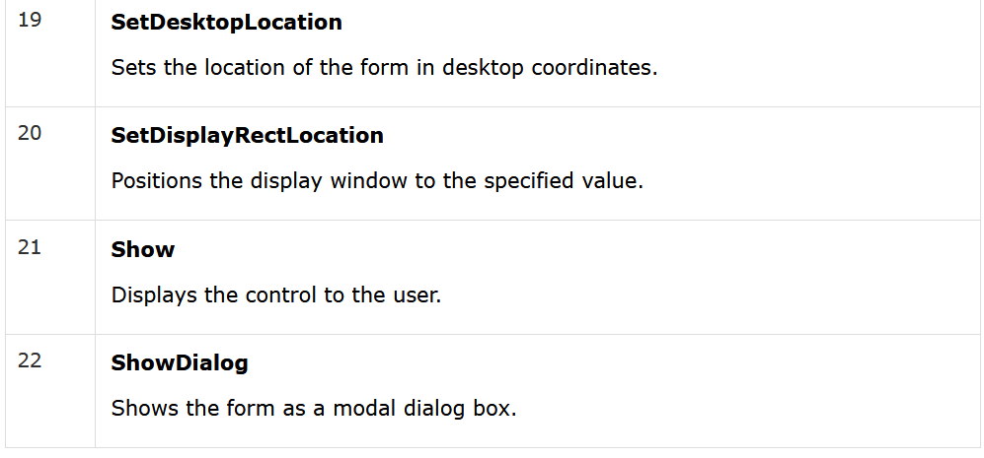
Cont.…

Slide 39
Form Events
Events: are what happens when an object does something.
Following table lists down various important events related to a form.
You can refer to Microsoft documentation for a complete list of events associated with forms control

Slide 40
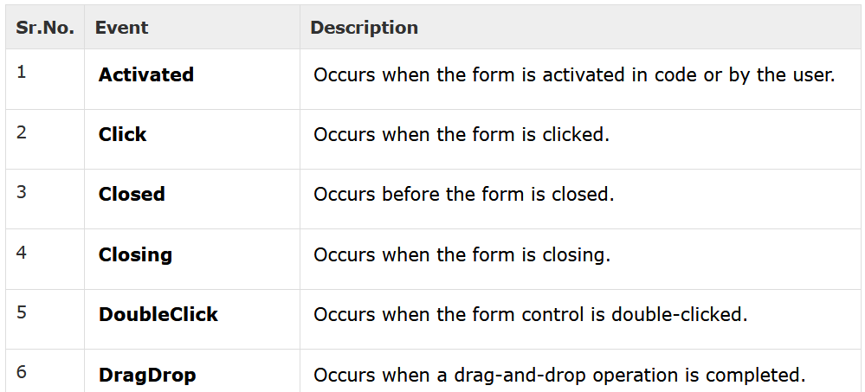
Cont.…

Slide 41
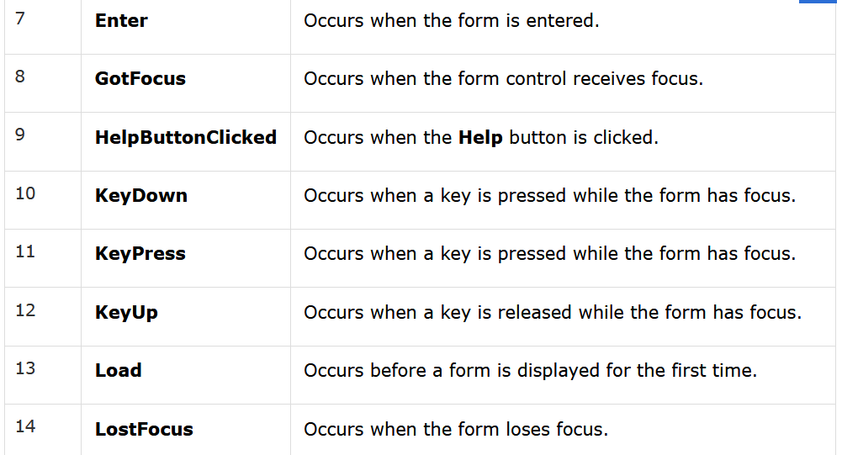
Cont.…

Slide 42
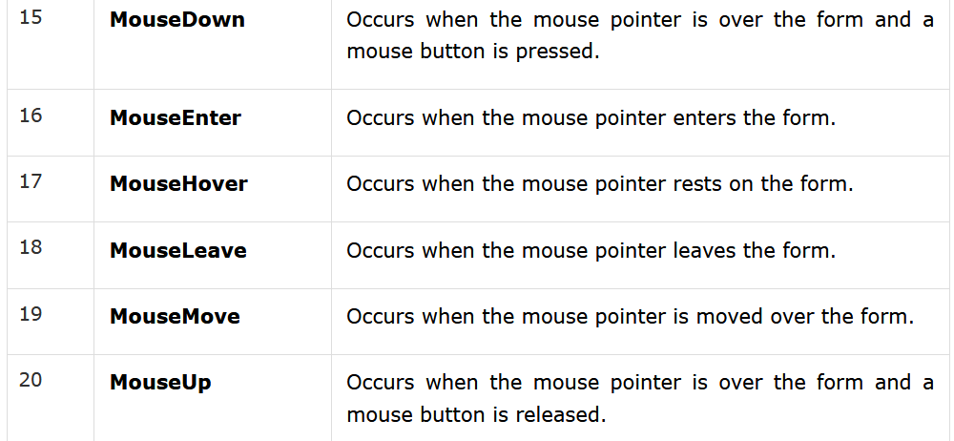
Cont.…

Slide 43
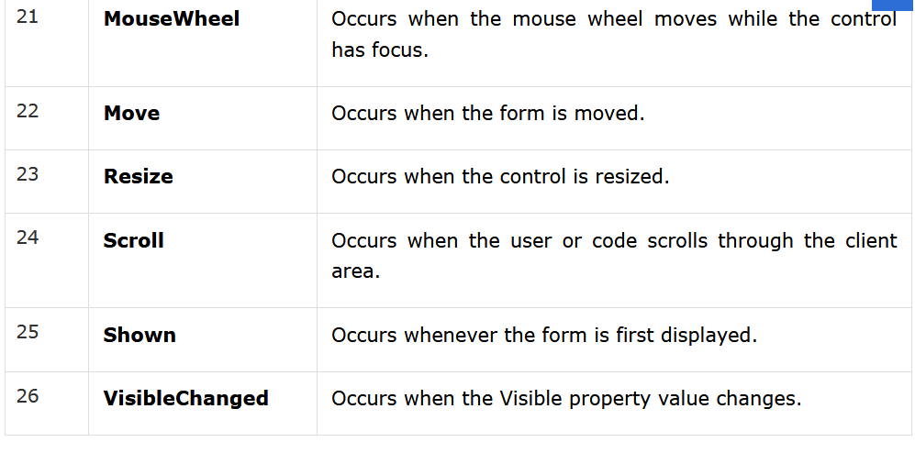
Cont.…

Slide 44
Text-Box Events => Key-down event
Used to capture which key is pressed by the user
private void textBox1_KeyDown(object sender, KeyEventArgs e)
{
if (e.KeyCode == Keys.A)
{
MessageBox.Show("You Pressed Letter A");
}
if (e.KeyCode == Keys.B)
{
MessageBox.Show("You Pressed Letter B");
}
}

Slide 45


=> Text Changed Event
This event raises when a user enters an input or set the Text property to a new value
private void textBox1_TextChanged(object sender, EventArgs e)
{
label1.Text = textBox1.Text;
}

Slide 46
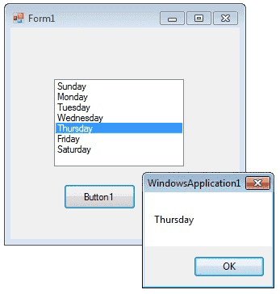
C# List-Box Control
The ListBox control enables you to display a list of items to the user that the user can select by clicking.
Used to display and selection functionality,
private void button1_Click (object sender, EventArgs e)
{
MessageBox.Show(listBox1.Text);
}

Slide 47
Cont…
You can use the Add method to add items to a list box.
The Add method adds new items at the end of an unsorted list box.

Slide 48
Cont…
private void Form1_Load(object sender, EventArgs e)
{
listBox1.Items.Add("IT");
listBox1.Items.Add("SW");
listBox1.Items.Add("CS");
}
If you want to retrieve a single selected item to a variable, you can code like this
string var;
var = listBox1.Text;

Slide 49
Cont…
The SelectionMode property determines how many items in the list can be selected at a time.
A ListBox control can provide single or multiple selections using the SelectionMode property.
If you change the selection mode property to multiple select, then you will retrieve a collection of items from ListBox1.
SelectedItems property.
listBox1.SelectionMode = SelectionMode.MultiSimple;

Slide 50
Example
The following C# program displays the multiple selected items sequentially on button click event
Set the selection mode property to multi-simple
listBox1.SelectionMode = SelectionMode.MultiSimple;

Slide 51
Cont…
private void button1_Click(object sender, EventArgs e)
{
foreach (Object obj in listBox1.SelectedItems)
{
MessageBox.Show(obj.ToString());
}
}

Slide 52
How to bind a List-Box to a List ?
Binding is an operation performed by the compiler or runtime
When an object is assigned to an object variable of the specific type, then the C# compiler performs the binding with the help of .Net Framework
Used to find the definition of a symbol that corresponds to the use of that symbol in a particular context

Slide 53
Cont…
First you should create a fresh List Object and add items to the List.
private void Form1_Load(object sender, EventArgs e)
{
List<string> nList = new List<string>();
nList.Add("January");
nList.Add("February");
nList.Add("March");
nList.Add("April");
}

Slide 54
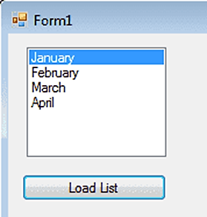
Cont…
The next step is to bind this List to the Listbox.
In order to do that you should set datasource of the Listbox.
listBox1.DataSource = nList;

Slide 55
Cont…
Full Source code
private void button1_Click(object sender, EventArgs e)
{
List<string> nList = new List<string>();
nList.Add("January");
nList.Add("February");
nList.Add("March");
nList.Add("April");
listBox1.DataSource = nList;
}

Slide 56
SelectedIndexChanged event
This event is fired when the item selection is changed in a List-Box.
You can use this event in a situation that you want select an item from your list-box and according to this selection you can perform other programming needs.
You can add the event handler using the Properties Window and selecting the Event icon and double-clicking on SelectedIndexChanged as you can see in following image.
When you double click on List-Box the code will automatically come in you code editor like the following code

Slide 57
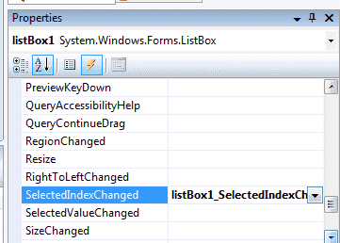
Cont…

Slide 58
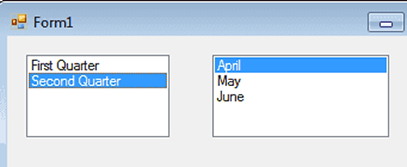
Cont…
From the following example you can understand how to fire the SelectedIndexChanged event.

Slide 59
Cont…
List<string> fQ = new List<string>();
List<string> sQ = new List<string>();
private void Form1_Load(object sender, EventArgs e)
{
List<string> nList = new List<string>();
nList.Add("First Quarter");
nList.Add("Second Quarter");
listBox1.DataSource = nList;
fQ.Add("January");
fQ.Add("February");
fQ.Add("March");
sQ.Add("April");
sQ.Add("May");
sQ.Add("June");
}

Slide 60
Cont…
private void listBox1_SelectedIndexChanged(object sender, EventArgs e)
{
if (listBox1.SelectedIndex == 0)
{
listBox2.DataSource = null;
listBox2.DataSource = fQ;
}
else if (listBox1.SelectedIndex == 1)
{
listBox2.DataSource = null;
listBox2.DataSource = sQ;
}
}

Slide 61
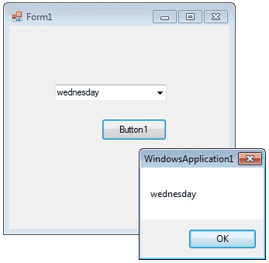
C# Combo-Box Control
A Combo Box displays a Text-box combined with a List-box, which enables the user to select items from the list or enter a new value.
private void button1_Click(object sender, EventArgs e)
{
MessageBox.Show(comboBox1.Text);
}

Slide 62
Cont.…
You can add individual objects with the Add method.
You can delete items with the Remove method or clear the entire list with the Clear method.
private void Form1_Load(object sender, EventArgs e)
{
comboBox1.Items.Add("Sunday");
comboBox1.Items.Add("Monday");
comboBox1.Items.Add("Tuesday");
comboBox1.Items.Add("Wednesday");
comboBox1.Items.Add("Thursday");
comboBox1.Items.Add("Friday");
comboBox1.Items.Remove("Thursday");
}

Slide 63
Cont.…
You can remove items from a combo-box in two ways.
You can remove item at the specified index or giving a specified item by name.
comboBox1.Items.RemoveAt(1);
The above code will remove the second item from the combobox.
comboBox1.Items.Remove("Friday");
The above code will remove the item "Friday" from the combobox.
AND
comboBox1.Items.Clear(); - clears the entire list

Slide 64
Cont.…
How to set the selected item in a comboBox
2 ways
comboBox1.SelectedItem = "Friday"; or
comboBox1.SelectedIndex = comboBox1.FindStringExact("Friday ");

Slide 65
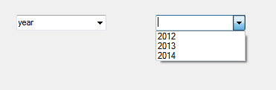
Example – Combon-Box SelectedIndexChanged event
private void Form1_Load(object sender, EventArgs e)
{
comboBox1.Items.Add("Day");
comboBox1.Items.Add("Year");
}
private void comboBox1_SelectedIndexChanged(object sender, EventArgs e)
{
comboBox2.Items.Clear();
if (comboBox1.SelectedItem == "Day")
{
comboBox2.Items.Add("Sunday");
comboBox2.Items.Add("Monday");
comboBox2.Items.Add("Tuesday");
}
else if (comboBox1.SelectedItem == "Year")
{
comboBox2.Items.Add("2012");
comboBox2.Items.Add("2013");
comboBox2.Items.Add("2014");
}
}
If you want to do something when you change the selection, you can write the program on SelectedIndexChanged event.

Slide 66
Cont.…
Read Only Combo Box
You can make a ComboBox readonly, that means a user cannot write in a combobox but he can select the given items, in two ways.
By default, DropDownStyle property of a Combobox is DropDown. In this case user can enter values to combobox.
When you change the DropDownStyle property to DropDownList, the Combobox will become read only and user cannot enter values to combobox.
Second method, if you want the combobox completely read only, you can set
comboBox1.Enabled = false.

Slide 67
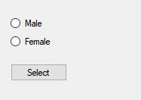
C# RadioButton Control
A radio button or option button enables the user to select a single option from a group of choices when paired with other RadioButton controls.

Slide 68
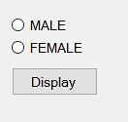
Cont…
The RadioButton control can display text, an Image, or both.
Use the Checked property to get or set the state of a RadioButton.
radioButton1.Checked = true;

Slide 69
Cont…
private void button1_Click_1(object sender, EventArgs e)
{
if(radioButton1.Checked==true)
{
MessageBox.Show("You are male");
}
if(radioButton2.Checked==true)
{
MessageBox.Show("You are female");
}
}

Slide 70
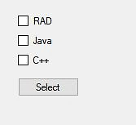
C# Check-Box Control
CheckBoxes allow the user to make multiple selections from a number of options.

Slide 71
Cont…
private void button1_Click_1(object sender, EventArgs e)
{
string msg="";
if (checkBox1.Checked == true)
{
MessageBox.Show(msg + checkBox1.Text);
}
if (checkBox2.Checked == true)
{
MessageBox.Show(msg + checkBox2.Text);
}
if (checkBox3.Checked == true)
{
MessageBox.Show(msg + checkBox3.Text);
}
if (checkBox1.Checked == false && checkBox2.Checked == false && checkBox3.Checked == false)
{
MessageBox.Show("Check Box Not Selected");
}
}

Slide 72
Cont…
You can use the CheckBox control Three State property to direct the control to return the Checked, Unchecked, and Indeterminate values.
You need to set the check boxs ThreeState property to True to indicate that you want it to support three states.
checkBox1.ThreeState = true;

Slide 73
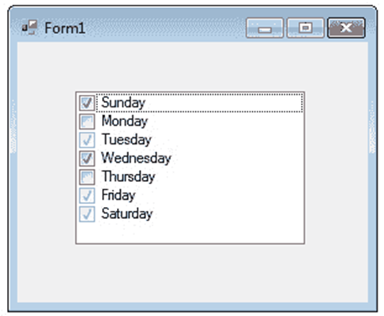
C# Checked ListBox Control
The CheckedListBox control gives you all the capability of a list box and also allows you to display a check mark next to the items in the list box.

Slide 74
Cont…
private void Form1_Load(object sender, EventArgs e)
{
checkedListBox1.Items.Add("Sunday", CheckState.Checked);
checkedListBox1.Items.Add("Monday", CheckState.Unchecked);
checkedListBox1.Items.Add("Tuesday", CheckState.Indeterminate);
checkedListBox1.Items.Add("Wednesday", CheckState.Checked);
checkedListBox1.Items.Add("Thursday", CheckState.Unchecked);
checkedListBox1.Items.Add("Friday", CheckState.Indeterminate);
checkedListBox1.Items.Add("Saturday", CheckState.Indeterminate);
}
The user can place a check mark by one or more items

Slide 75
C# Picture-Box Control
The Windows Forms Picture-Box control is used to display images in bitmap, GIF , icon , or JPEG formats.
You can set the Image property to the Image you want to display, either at design time or at run time.
You can programmatically change the image displayed in a picture box, which is particularly useful when you use a single form to display different pieces of information.

Slide 76
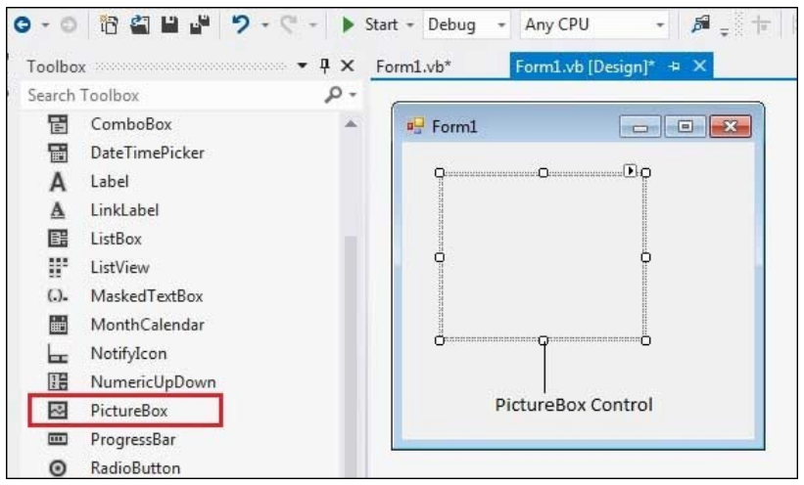
Cont…
The Picture-Box control is used for displaying images on the form.
The Image property of the control allows you to set an image both at design time or at run time.
Let's create a picture box by dragging a Picture-Box control from the Toolbox and dropping it on the form.

Slide 77
Cont…
private void Form1_Load(object sender, EventArgs e)
{
pictureBox1.Image = Image.FromFile("C:\\Users\\Fan\\Desktop\\abb.jpg");
pictureBox1.SizeMode = PictureBoxSizeMode.StretchImage;
}
The Size-Mode property controls the clipping and positioning of the image in the display area.
It can be set using a code or using the property window

Slide 78
Cont…
There are five different PictureBoxSizeMode is available to PictureBox control.
Auto-size - sizes the picture box to the image.
Center-image - centers the image in the picture box.
Normal - places the upper-left corner of the image at upper left in the picture box
Stretch-image - allows you to stretch the image in code
Zoom- zooms the image

Slide 79
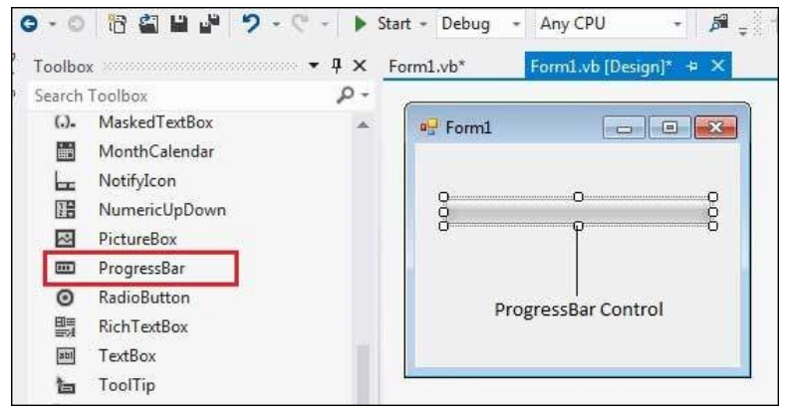
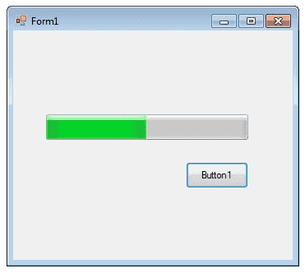
C# Progress-Bar Control
A progress bar is a control that an application can use to indicate the progress of a lengthy operation
Such as calculating a complex result,
Coping file,
Downloading a large file from the Web etc.
It is used to provide visual feedback to your users about the status of some task

Slide 80
Cont…
Progress-Bar controls are used whenever an operation takes a long period of time.
The Maximum and Minimum properties define the range of values to represent the progress of a task
Minimum : Sets the lower value for the range of valid values for progress.
Maximum : Sets the upper value for the range of valid values for progress.
Value : This property obtains or sets the current level of progress.

Slide 81
Cont…
By default, Minimum and Maximum are set to 0 and 100.
As the task proceeds, the Progress-Bar fills in from the left to the right.

Slide 82
Cont…
private void button1_Click(object sender, EventArgs e)
{
int i;
progressBar1.Minimum = 0;
progressBar1.Maximum = 100;
for (i = 0; i <= 100; i++)
{
progressBar1.Value = i;
}
}

Slide 83
C# Scroll-Bars Control
This is used for navigating through large amount of information.
The ScrollBar controls display vertical and horizontal scroll bars on the form.
There are two types of scroll bar controls:
HScrollBar for horizontal scroll bars and
VScrollBar for vertical scroll bars. These are used independently from each other.
Let's click on HScrollBar control and VScrollBar control from the Toolbox and place them on the form.

Slide 84
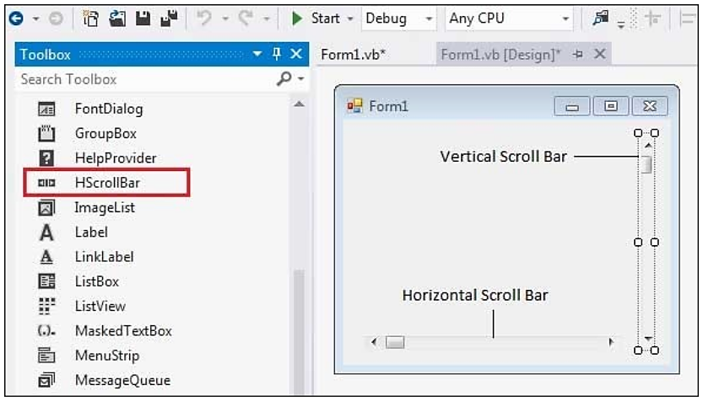
Cont…

Slide 85
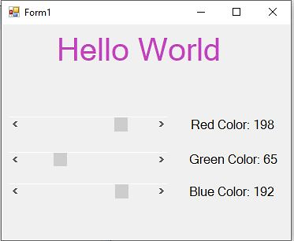
Example
Set Scroll bar properties
Maximum = 255
Minimum = 0
Large Change = 0

Slide 86
Example
private void hScrollBar1_Scroll(object sender, ScrollEventArgs e)
{
hello.ForeColor = Color.FromArgb(hScrollBar1.Value, hScrollBar2.Value, hScrollBar3.Value);
label1.Text = "Red Color: " + hScrollBar1.Value.ToString();
}
private void hScrollBar2_Scroll(object sender, ScrollEventArgs e)
{
hello.ForeColor = Color.FromArgb(hScrollBar1.Value, hScrollBar2.Value, hScrollBar3.Value);
label2.Text = "Green Color: " + hScrollBar2.Value.ToString();
}
private void hScrollBar3_Scroll(object sender, ScrollEventArgs e)
{
hello.ForeColor = Color.FromArgb(hScrollBar1.Value, hScrollBar2.Value, hScrollBar3.Value);
label3.Text = "Blue Color: " + hScrollBar3.Value.ToString();
}

Slide 87
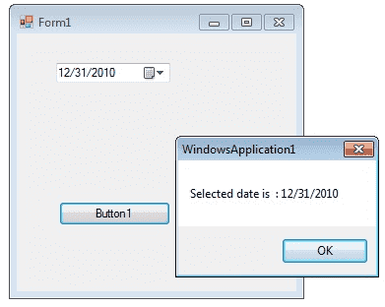
C# Date-Time-Picker Control
The DateTimePicker control allows you to display and collect date and time from the user with a specified format.
The DateTimePicker control has two parts are:-
A label that displays the selected date and
A popup calendar that allows users to select a new date.

Slide 88
Cont…
The most important property of the DateTimePicker is the Value property, which holds the selected date and time.
dateTimePicker1.Value = DateTime.Today;
The Value property contains the current date and time the control is set to.

Slide 89
Cont…
The control can display one of several styles, depending on its property values.
The values can be displayed in four formats, which are set by the Format property: Long, Short, Time, or Custom.
dateTimePicker1.Format=DateTimePickerFormat.Short;

Slide 90
Example
private void Form1_Load(object sender, EventArgs e)
{
dateTimePicker1.Format = DateTimePickerFormat.Time;
dateTimePicker1.Value = DateTime.Today;
}
private void button2_Click(object sender, EventArgs e)
{
DateTime Date;
Date = dateTimePicker1.Value;
MessageBox.Show("Selected date is " + Date);
}

Slide 91
Convert String to DateTime
You can use the methods like
Convert.ToDateTime(String),
DateTime.Parse() and
DateTime.ParseExact() methods for converting a string-based date to a System.DateTime object.
Example
private void button1_Click(object sender, EventArgs e)
{
string iDate = "05/05/2005";
DateTime oDate = Convert.ToDateTime(iDate);
MessageBox.Show(oDate.Day + "-" + oDate.Month + "-" + oDate.Year);
}

Slide 92
Date difference
The DateTime.Substract method may be used in order to find the date-time difference between two instances of the DateTime method.
private void button1_Click(object sender, EventArgs e)
{
// creating object of DateTime
DateTime date1 = new DateTime(2011,1,1);
DateTime date2 = new DateTime(2010,12,1);
// using Subtract() method;
TimeSpan value = date1.Subtract(date2);
MessageBox.Show("TimeSpan between date1 and date two is "+ value);
}

Slide 93
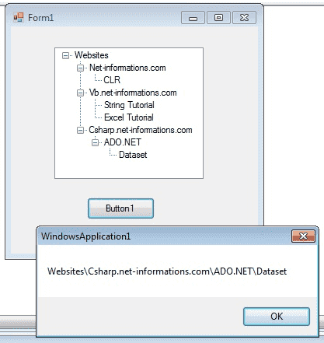
C# Tree-view Control
The TreeView control contains a hierarchy of TreeViewItem controls.
Display information in a hierarchical structure by using collapsible nodes.
The top level in a tree view are root nodes that can be expanded or collapsed if the nodes have child nodes.

Slide 94
Cont…
The user can expand the TreeNode by clicking the plus sign (+) button, if one is displayed next to the TreeNode, or
You can expand the TreeNode by calling the TreeNode.Expand method.
You can also navigate through tree views with various properties:
FirstNode, LastNode,
NextNode, PrevNode,
NextVisibleNode, PrevVisibleNode.

Slide 95
Cont…
The FullPath method of tree view control provides the path from root node to the selected node.
treeView1.SelectedNode.FullPath.ToString ();
Tree nodes can optionally display check boxes.
To display the check boxes, set the CheckBoxes property of the TreeView to true.
treeView1.CheckBoxes = true;

Slide 96
Cont…
private void Form1_Load(object sender, EventArgs e)
{
TreeNode tNode;
tNode = treeView1.Nodes.Add("Websites");
treeView1.Nodes[0].Nodes.Add("Net-informations.com");
treeView1.Nodes[0].Nodes[0].Nodes.Add("CLR");
treeView1.Nodes[0].Nodes.Add("Vb.net-informations.com");
treeView1.Nodes[0].Nodes[1].Nodes.Add("String Tutorial");
treeView1.Nodes[0].Nodes[1].Nodes.Add("Excel Tutorial");
treeView1.Nodes[0].Nodes.Add("Csharp.net-informations.com");
treeView1.Nodes[0].Nodes[2].Nodes.Add("ADO.NET");
treeView1.Nodes[0].Nodes[2].Nodes[0].Nodes.Add("Dataset");
}
private void button3_Click(object sender, EventArgs e)
{
MessageBox.Show(treeView1.SelectedNode.FullPath.ToString());
}

Slide 97
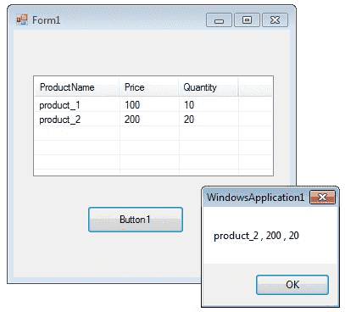
C# ListView Control
The ListView control is an ItemsControl that is derived from ListBox.

Slide 98
Add Columns in List-View
You can add columns in List-view by using Columns.Add() method. This method takes two arguments,
First one is the column heading and
Second one the column width.
listView1.Columns.Add("ProductName", 100);

Slide 99
Add Item in Listview
You can add items in listbox using ListViewItem which represents an item in a ListView control
string[] arr = new string[4];
ListViewItem itm ;
//add items to ListView
arr[0] = "product_1";
arr[1] = "200";
arr[2] = "20";
itm = new ListViewItem(arr);
listView1.Items.Add(itm);

Slide 100
Get selected item from List-View
This code will return the item from first column of first row.
productName =listView1.SelectedItems[0].SubItems[0].Text;
Sorting Listview Items
If the Sorted property of Listview is set to true, then the ListView items are sorted.
The following code sorts the ListView items:
listView1.Sorted = true;
Add Checkbox in List-view
listView1.CheckBoxes = true;

Slide 101
Example
private void Form1_Load(object sender, EventArgs e)
{
listView1.CheckBoxes = true;
// listView1.Columns.Add(text, width, alignment);
listView1.View = View.Details;
listView1.GridLines = true;
listView1.FullRowSelect = true;
//Add column header
listView1.Columns.Add("ProductName", 100);
listView1.Columns.Add("Price", 70);
listView1.Columns.Add("Quantity", 70);
//Add items in the listview
string[] arr = new string[4];
ListViewItem itm;
//Add first item
arr[0] = "product_1";
arr[1] = "100";
arr[2] = "10";
itm = new ListViewItem(arr);
listView1.Items.Add(itm);
//Add second item
arr[0] = "product_2";
arr[1] = "200";
arr[2] = "20";
itm = new ListViewItem(arr);
listView1.Items.Add(itm);
}

Slide 102
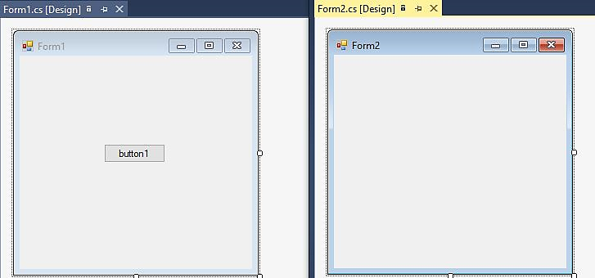
Linking two forms
private void button1_Click(object sender, EventArgs e)
{
Form2 xy = new Form2();
xy.Show();
this.Hide();
}

Slide 103
The end!

